Slide 1
Predicting the success of a mobile app
DATA 621: Group 3

Slide 2
Introduction
In 2014 Dong Nguyen revealed that his game Flappy Bird was earning an average of $50,000 a day from in-app ads. At that time, Flappy Bird, an addictive and tough game, had been number 1 on the Apple App Store and Google Play Store for almost a month and was gaining more downloads daily. In fact, by January 2014 the app had 50 million downloads, 68,000 reviews, and held the number 1 spot for most downloaded free game in 53 countries.
With millions of apps available for download today, many app developers could only dream of the success that Flappy Bird saw. So, did Nguyen know how to make an app so successful, and is there any way for us use app statistics to predict the success of an app? Kaggle has a couple of datasets with mobile application statistics that can possibly help us answer these questions. The datasets contain information around Apple apps on the App Store and Google apps on the Play Store; information centered around ratings, app size, installs, and price. Our idea is to take these datasets to see if we can use several regression methods to predict the successfulness of an app.

Slide 3
Methodology

Slide 4
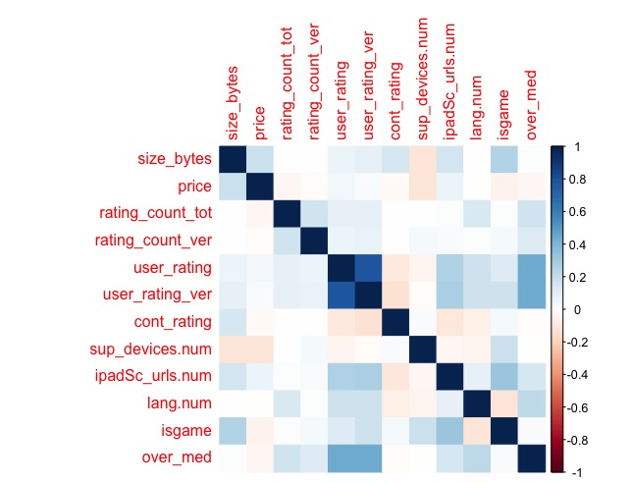
APPLE STORE Dataset
2018 - 2019 NBA Regular Season

